Slide 1


SUPERMARKET Sales Presentation
Presenter: Skillarchie Davis
Last Updated: 28/10/24

Slide 2
Presentation Flow
Project Overview
Project Objectives
Key Findings
Recommendation
Questions

Slide 3
Project overview
The supermarket sales dataset was retrieved from Kaggle. The dataset contains information and data on historical sales data for a supermarket in the Myanmar for three cities over a three (3) months period. In the data preparation stage, I garnered an understanding of the dataset. Firstly, I cleaned the dataset. Secondly, I transformed the data to gather more meaningful insights for the data exploration stage. Thirdly, during the data exploration stage I created the dashboard. Finally, I then publish the dashboard for the presentation of my findings.

Slide 4
Project Objectives
Analyse data trends.
Sales optimization.

Slide 5

Key INSIGHTS

Slide 6
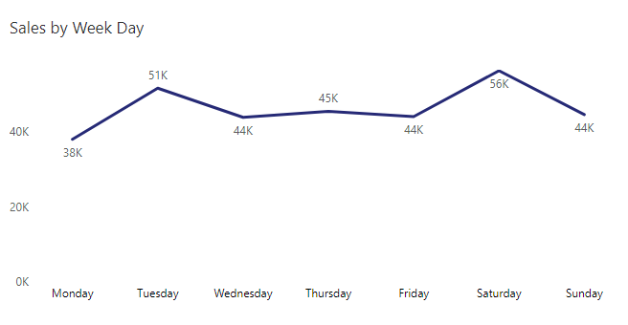
Sales by Weekdays
Tuesdays and Saturdays generate the most sales.
Mondays is worst performing day for sales.
Sales are stable from Wednesday to Friday.

Slide 7
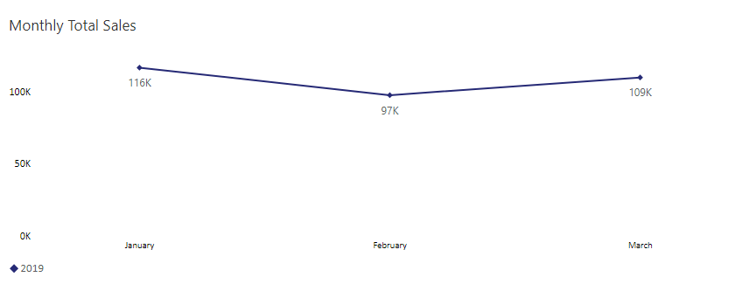
Sales by Month
Most of the supermarket sales happened in January.
There is a sharp decline in sales in February then an increase in March.

Slide 8
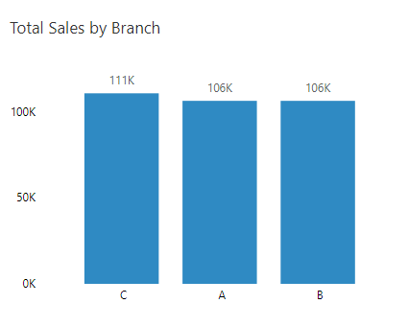
Sales by BRANCH
Branch C is the best performing branch.
Both Branch A and B are generating the same amount in sales.

Slide 9
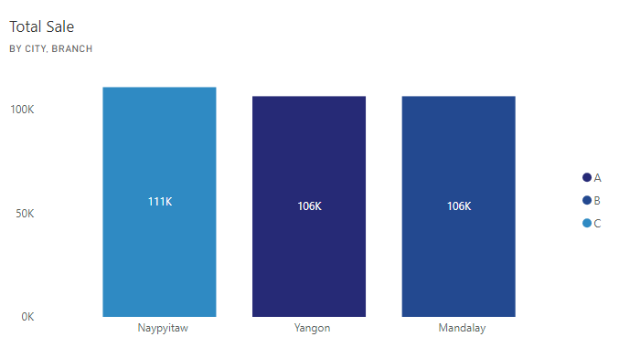
Sales by CITY AND BRANCH
Naypyitaw is the best performing city where branch C is located.
Both City Yangon and Mandalay where branch A and B are located respectfully are generating the same amount in sales.

Slide 10
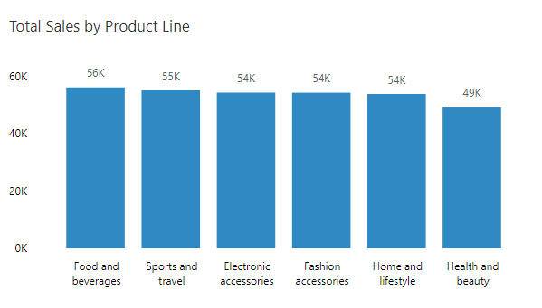
Sales by PRODUCT LINE
Food and beverages is the best performing product.
Health and beauty generates the least sales.

Slide 11
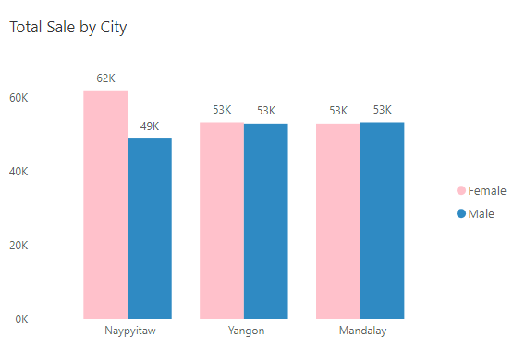
Sales by CITY AND GENDER
Most of the sales for Naypyitaw comes from females.
Majority of the sales comes from females.

Slide 12
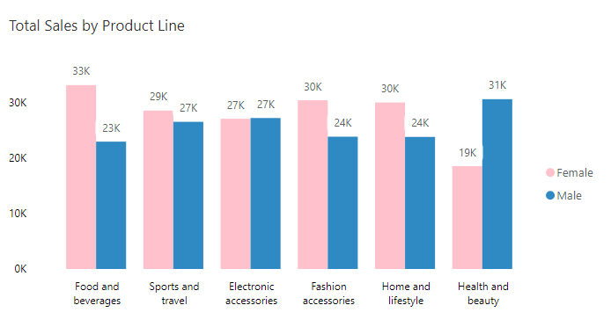
Sales by Product LINE AND GENDER
Females spend the most on everything except Electronic Accessories and Health and beauty.
Surprisingly, males spend the most on health and beauty products.

Slide 13
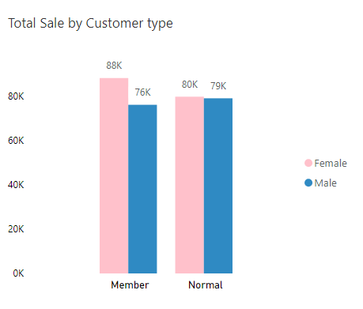
Sales by CUSTOMER TYPE AND GENDER
Females spend the most for both membership and casual buyers.

Slide 14
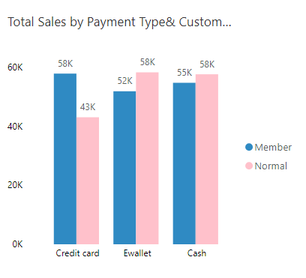
Sales by Payment type and CUSTOMER TYPE
Members mostly use their credit card.
The casual buyer is more comfortable using both Ewallet and cash to buy our products.

Slide 15
RECOMMENDATIONS
Release new product line offerings during the month January and March on Tuesdays, Thursday and Saturdays.
Introduce a supermarket credit card for members.
Introduce Electronic Wallet for casual buyers.
Advertise on Thursday and Saturdays to casual buyers to become member.
Give a 15 – 35% discount on Electronic Accessories for new members.
Give a 15 – 35% discount on products during the month of February.
Give bargain and discounts for all products line except health and beauty on Mondays.

Slide 16

Questions

